Slide 1
PROFINET – An Introduction

Slide 2
PROFINET Introduction

Slide 3


What is PROFINET?
Ethernet open standard (IEC 61158) defined by PI (PROFIBUS and PROFINET International)
Fulfils Industrial Ethernet requirements
Uses TCP/IP and IT standards
Used for real time communication
Capabilities
Allows a smooth and easy integration of other legacy Field-buses
Simple distributed I/O and time-critical applications can be integrated into Ethernet communication
PROFINET is not PROFIBUS on Ethernet – It is much more!

Slide 4
Why PROFINET?
PROFINET applies the Ethernet standard to automation. PROFINET enables high-speed (millisecond) and secure data exchange at all levels, and so makes it possible to implement innovative machine and plant concepts.
Flexibility and openness - PROFINET offers users maximum freedom in structuring their machine and plant architectures using Fiber optic and Wired/Wireless networks.
PROFINET‘s efficiency means optimal use of available user resources, and a significant increase in plant availability. Innovative Profinet products and the performance of PROFINET provide a sustained boost to company productivity.
Easy to implement since it is Ethernet based

Slide 5
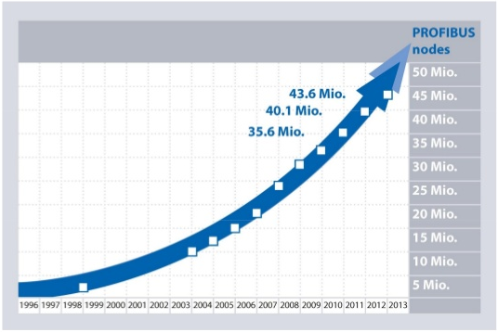
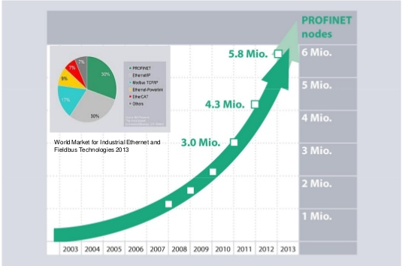
PROFIBUS and PROFINET Nodes
PROFIBUS Nodes PROFINET Nodes
PROFINET is catching up PROFIBUS DP at faster rate!

Slide 6
PROFINET Myths and Facts
PROFIBUS runs at up to 12Mbit/s, whereas PROFINET runs at 100Mbit/s. Therefore PROFINET is about 8 times faster than PROFIBUS.
NOT TRUE!
PROFINET gives very similar performance to PROFIBUS.
PROFINET will replace PROFIBUS in the next five years.
NOT TRUE!
PROFINET will replace some PROFIBUS DP devices, but PROFIBUS PA will continue.
Both DP and PA will be supported for many years to come.
PROFINET is not standard Ethernet
NOT TRUE!
PROFINET always uses completely standard Ethernet. It just doesn’t always use TCP/IP protocols – only for not time critical communications.

Slide 7
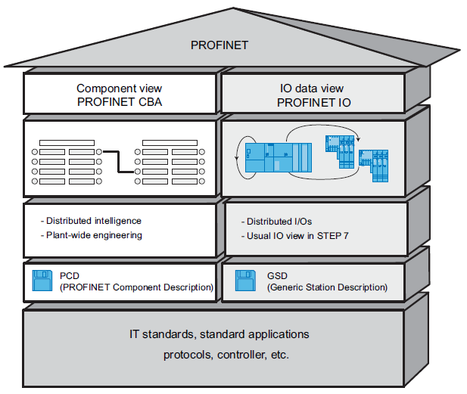
PROFINET Concepts
PROFINET IO
Used for modular distributed applications using Remote I/Os, Drives, HMIs, Smart MCCs
PROFINET CBA (Component Based Automation)
Used for Machine to Machine communication

Slide 8
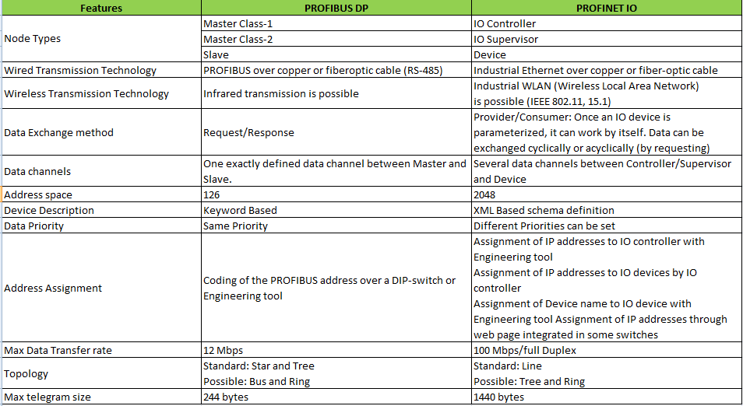
PROFINET Vs PROFIBUS

Slide 9
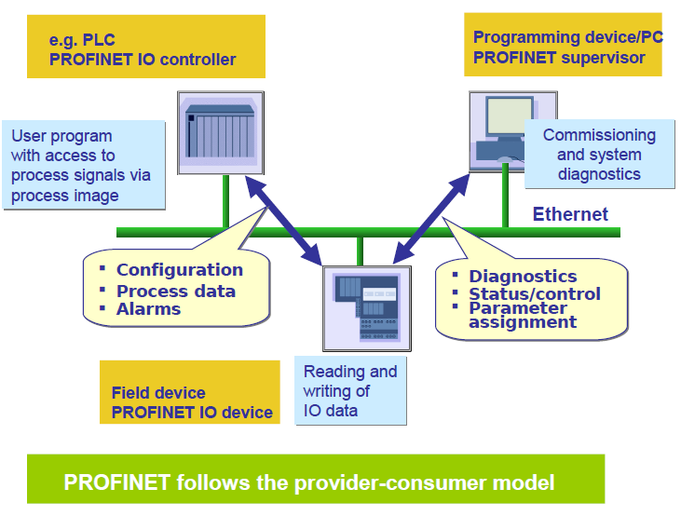
PROFINET Components

Slide 10
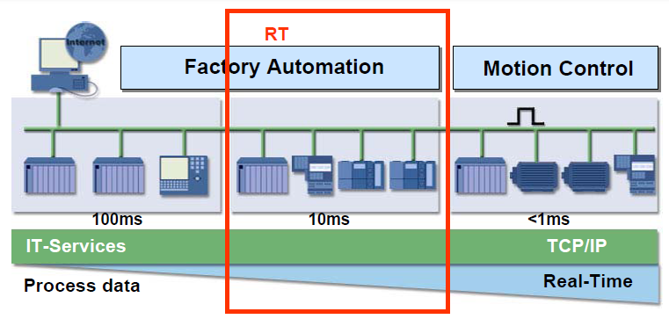
PROFINET Protocol Variations
PROFINET RT (Real Time)
RTA – RT Acyclic (Alarms, Configuration)
RTC – RT Cyclic (Data Communication)
PROFINET IRT (Isochronous Real time)
PROFINET NRT(Non Real Time)

Slide 11
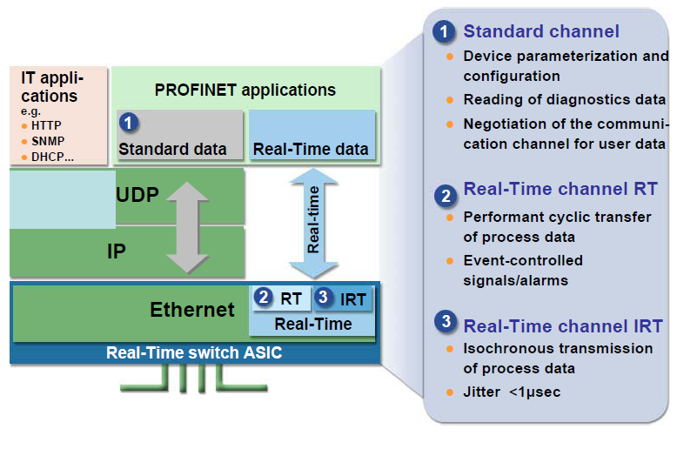
PROFINET Real-Time communication

Slide 12
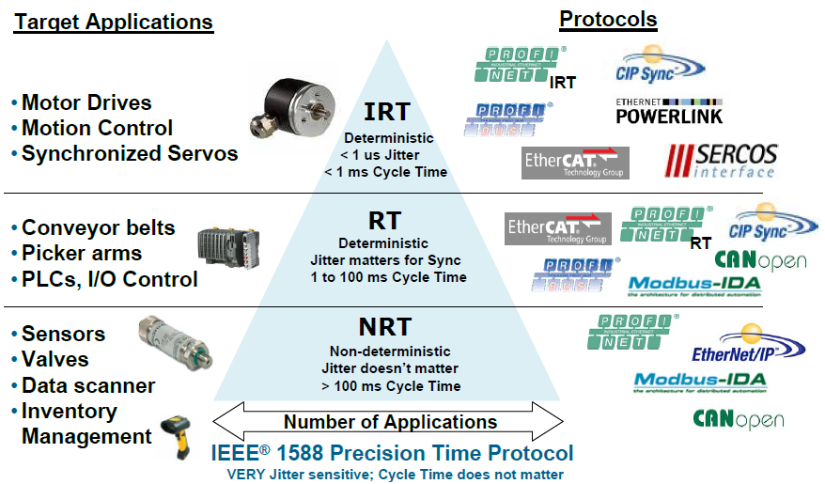
Real Time Protocols

Slide 13
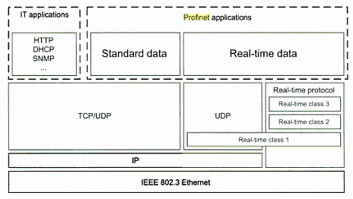
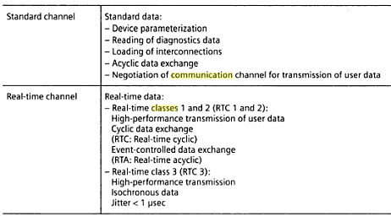
PROFINET RT Classes
RT Class-1 : Standard Communication, Used for Cyclic/acyclic data, no special switches are required
RT Class-2 : Real time Communication, Used for Cyclic data, special switches are required
RT Class-3 (IRT) : Isochronous Real time Communication, Used for Cyclic data in motion control applications , special switches and explicit communication planning are required

Slide 14
PROFINET Redundancy Classes
Redundancy Class1 (MRP-Media Redundancy Protocol)
Ring redundancy for applications with typical switching times of 200 ms
Redundancy Class2 (MRP + MRRT-Media Redundancy Real Time)
Ring redundancy for RT requirements, switching times of a few ms
Redundancy Class3 (MRP +MRRT+ IRT Planning)
Ring redundancy for IRT requirements with bump-less switching

Slide 15
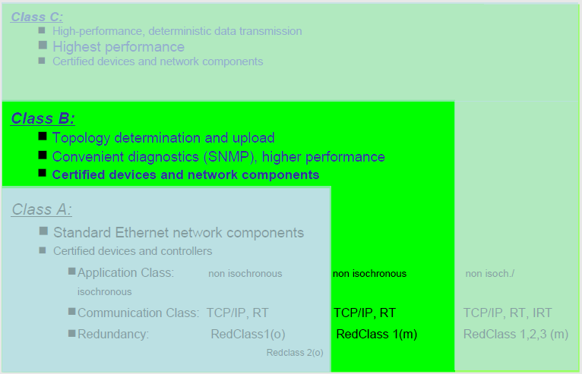
PROFINET Conformance Classes

Slide 16
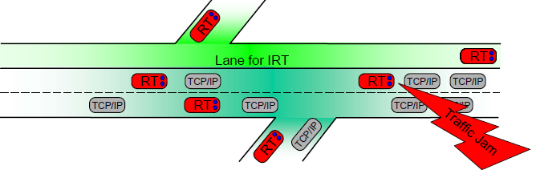
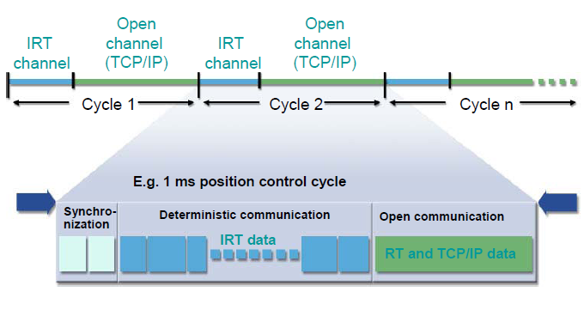
PROFINET Communication Bandwidth

Slide 17
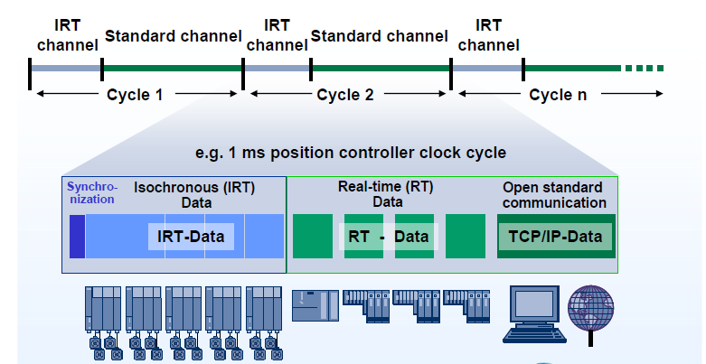
PROFINET Bandwidth Reservation

Slide 18
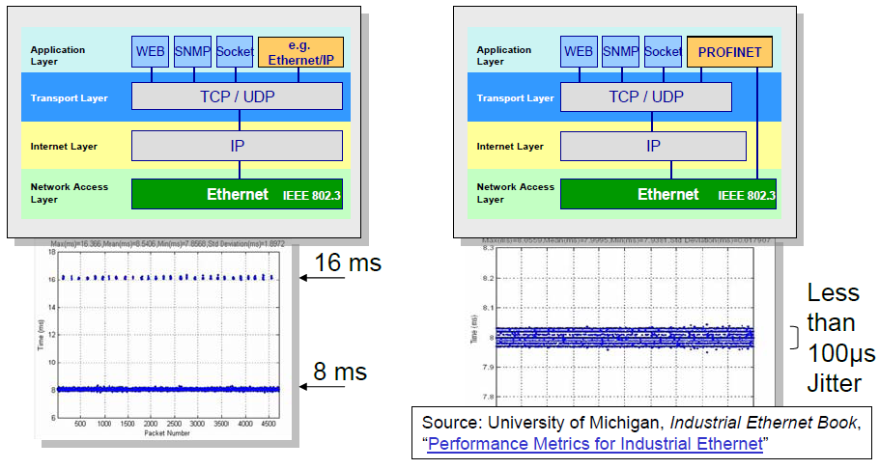
PROFINET –Real Time
When you try to use all layers..

Slide 19
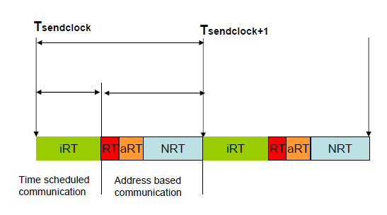
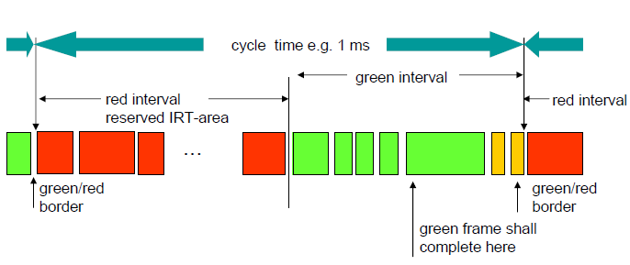
PROFINET Communication Bandwidth

Slide 20
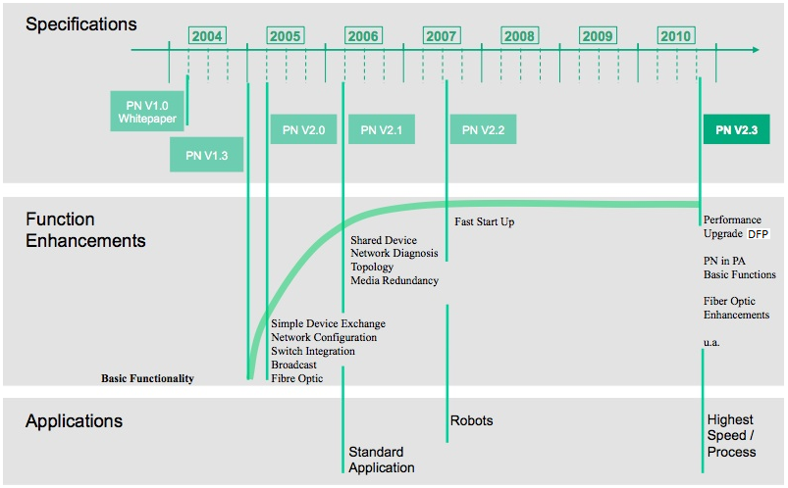
PROFINET Standard -Versions

Slide 21
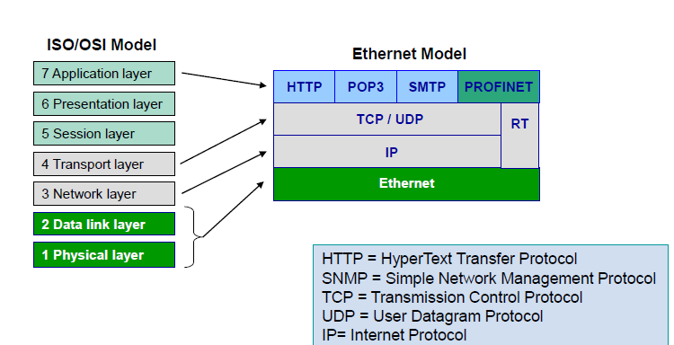
PROFINET ISO/OSI Model

Slide 22
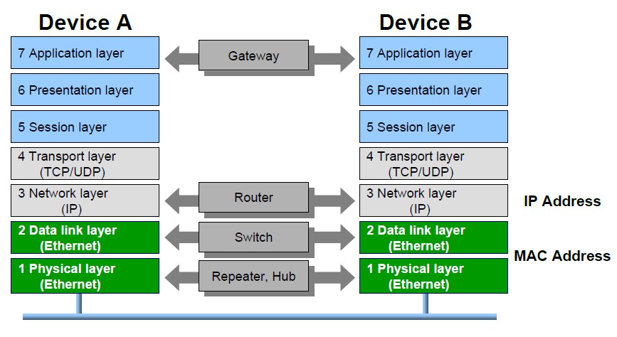
PROFINET ISO/OSI Model

Slide 23
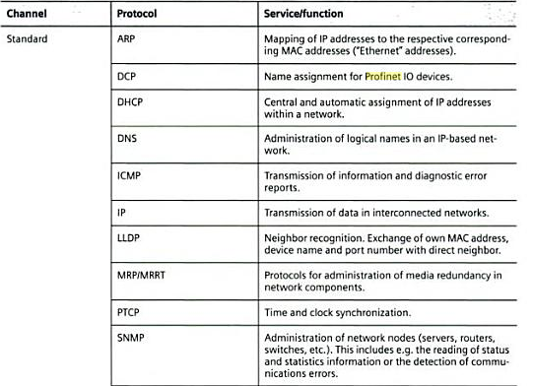
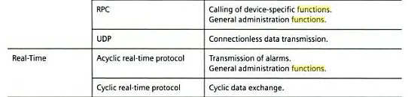
PROFINET Protocols

Slide 24
PROFINET IO RT

Slide 25
PROFINET IO RT Protocol
PROFINET IO is used for data exchange between I/O controllers (PLC, etc.) and I/O devices (field devices).
ROFINET IO uses the proven communication model and application view of PROFIBUS DP and extends it by Ethernet as the communication medium. Among other benefits, this provides a greater bandwidth and allows more stations on the network.
The PROFINET IO specifications define a protocol and an application interface for exchanging I/O data, alarms and diagnostics and for transmitting data records and logbook information. To exchange I/O data and alarms, PROFINET IO is based directly on the Ethernet protocol.
This real-time (RT) solution allows response times in the range of 5 ms, which corresponds to today‘s PROFIBUS DP applications.

Slide 26
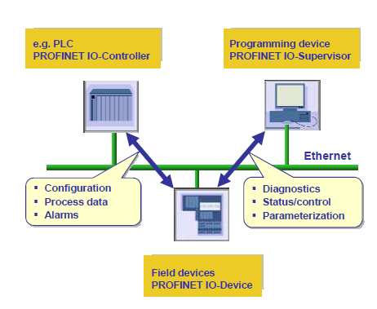
PROFINET IO RT Node Types
IO-Controller: This is typically the programmable logic controller (PLC) on which the automation program runs. This is comparable to a class 1 master in PROFIBUS. The IO-Controller provides output data to the configured IO-Devices in its role as provider and is the consumer of input data of IO-Devices (Ex: FCE PROFINET).
IO-Device: An IO-Device is a distributed I/O field device that is connected to one or more IO-Controllers via PROFINET IO. It is comparable to the function of a slave in PROFIBUS. The IO-Device is the provider of input data and the consumer of output data (Ex: PROFINET Drives).
IO-Supervisor: This can be a programming device, personal computer (PC), or human machine interface (HMI) device for commissioning or diagnostic purposes and corresponds to a class 2 master in PROFIBUS (Ex: Sycon.Net).

Slide 27
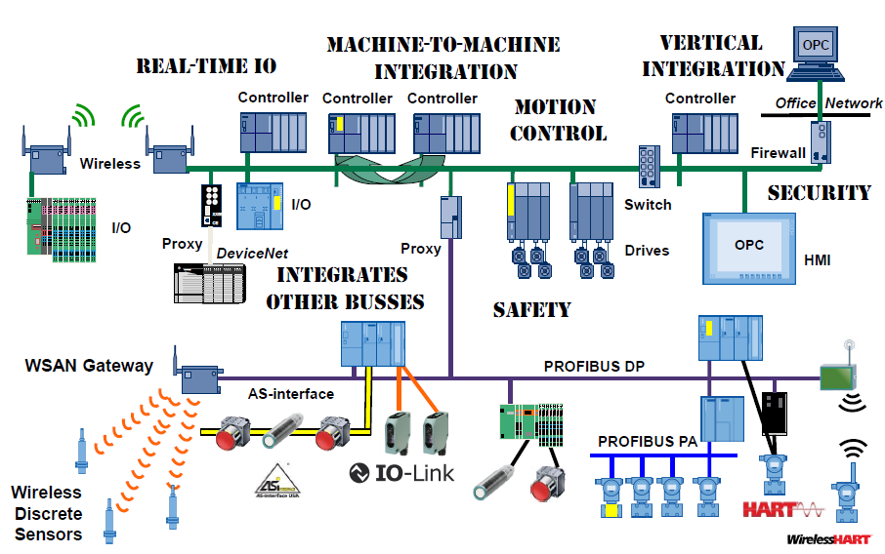
PROFINET Topology

Slide 28
PROFINET Protocols
RTA – Real Time Acyclic for Configuration, Alarms
RTC – Real Time Cyclic for Data
DCP – Discovery & Configuration Protocol for Device name assignment
LLDP – Link Layer Discovery Protocol for Topology identification
SNMP – Simple Network Management Protocol for Network diagnostics
MRP – Media Redundancy Protocol for Media Redundancy
PTCP - Precision Transparent Clock Protocol for Time Synchronization

Slide 29
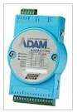
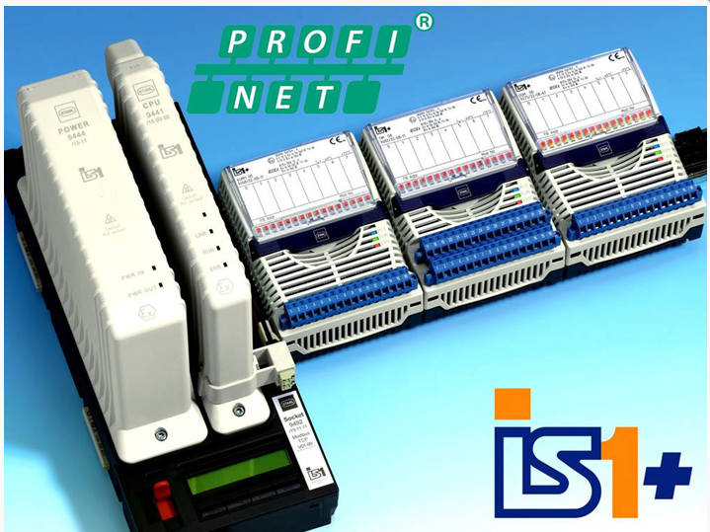
PROFINET Device Model
The PROFINET IO device model is comparable to PROFIBUS.
Compact field devices Modular field devices
(fixed degree of expansion) (variable degree of expansion)

Slide 30
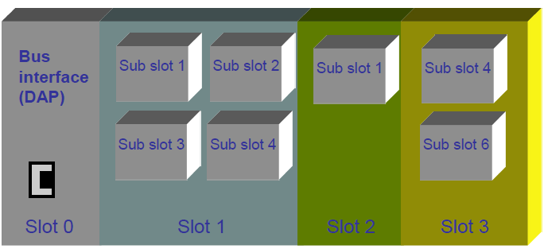
PROFINET Device Model
PROFIBUS IO modules and PROFINET bus interface (DAP*)→ IO device
I/O data are always assigned to sub-slots (real I/O channels).
Each sub-slot can contain I/O data or alarms.
I/O data are transferred with status information at the sub-slot level.
(DAP*)→ Device Access Point

Slide 31
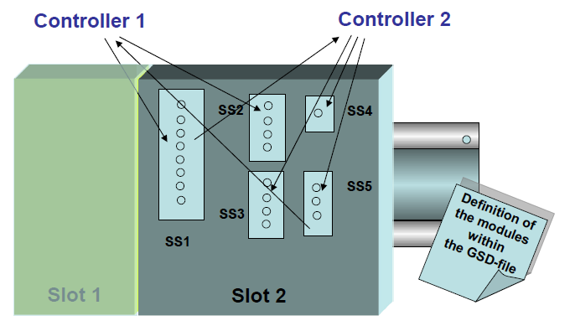

PROFINET Device Model
A Sub-slot is only allowed to be written by one Controller.

Slide 32
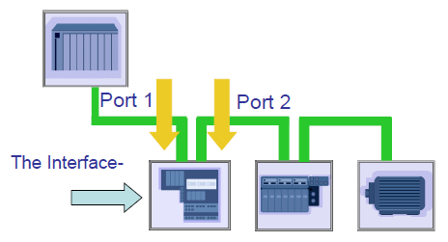
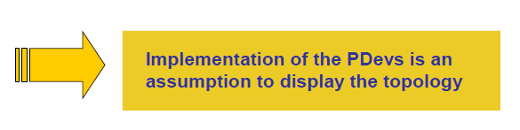
Physical Device Management (PDev)
The PDev manages all the hardware relevant data within a device
In parallel to SNMP, all diagnostics and topology information can also be called up from the PDEV (Physical Device Object) using acyclic PROFINET services.

Slide 33

PROFINET IO Device - Device Description
Description of Device properties are done using GSD files. It contains information about
Pluggable module type (AI 16 Channel etc)
Configuration data of the module
Configuration data of the channels (alarm limits, Input type etc)
Diagnostics information (wire break etc)
The GSD is XML based (called GSDML file)
Created and edited with standard XML editors (Ex. MS XML Notepad)
Structure of GSD Corresponds to the ISO 15745 Standard

Slide 34
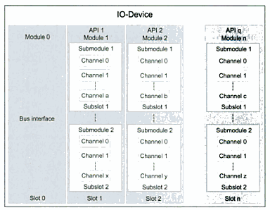
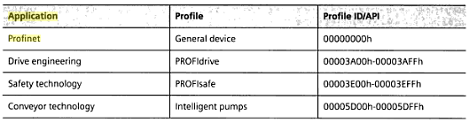
PROFINET APIs
API - Application Process Instance is an application inside PROFINET Device. Application Process Instance is addressed by APIx with default “0”. APIs>0 are reserved for Profiles.
A device may contain 1 or more APIs (Like ProfiDrive and ProfiSafe in a same device)

Slide 35
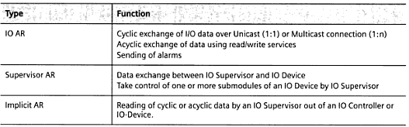
PROFINET Application Relations (ARs)
Describes the relation between publisher and subscriber
There may be one or more ARs between a device and controller
Data exchange is possible only if ARs exist between device and controller
There may be several ARs in a device to several IO controllers.
Types of ARs:

Slide 36
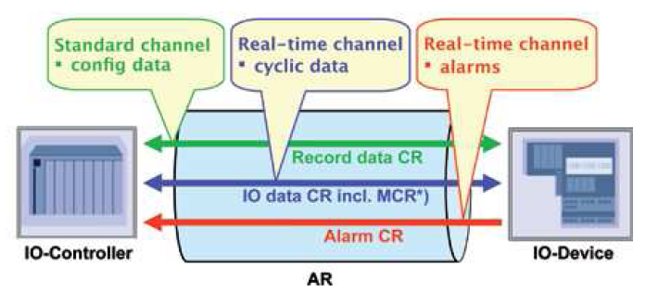
PROFINET Communication Relations
Communication Relations - CR: These specify the explicit communication channel between a consumer and a provider.
CRs within ARs are must for Data Exchange/Alarm notification.
Types of CRs:
* MCR – Multicast Communication Relation

Slide 37
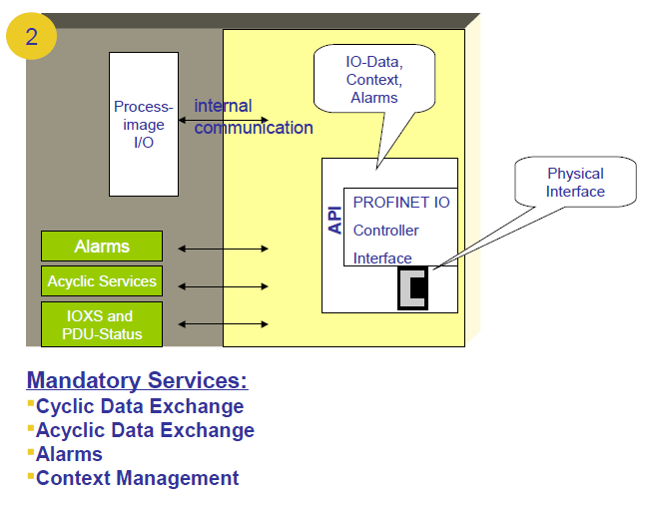
PROFINET Connections - Controller

Slide 38
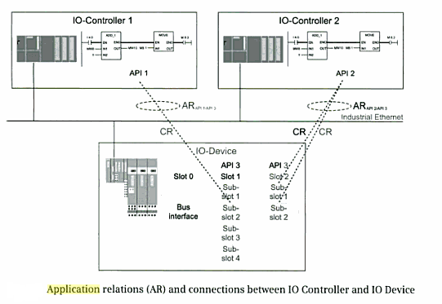
PROFINET Connections - Device

Slide 39
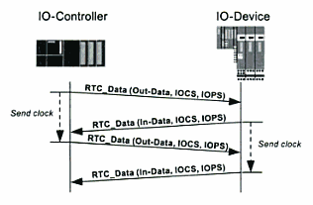
Cyclic I/O data
Cyclic I/O data between IO Device and IO Controller are exchanged using RTC Protocol
Each IO data item has 2 attributes IOCS and IOPS (IO Provider Status and IO Consumer Status)
IOPS is transmitted simultaneously with the data and therefore it is consistent with data value
IOCS can only be returned from consumer to Provider only after reception of data and therefore it is inconsistent with data value.
IOCS and IOPS can have values GOOD and BAD

Slide 40
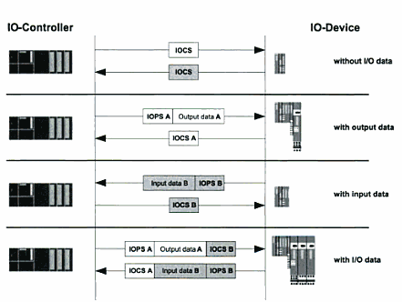
Cyclic I/O data
Cyclic I/O data sequence:

Slide 41
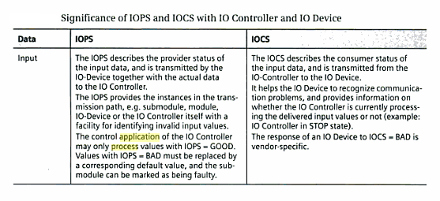
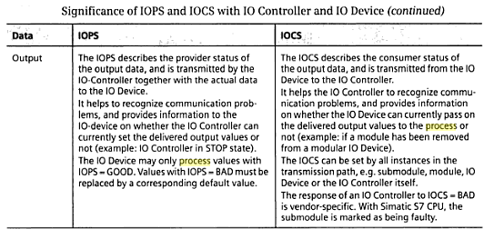
Cyclic I/O data

Slide 42
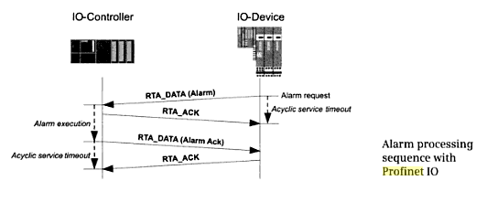
PROFINET I/O Alarms
Process events are signaled within a PROFINET IO configuration by means of Alarms
IO device transmits alarms with Priority as “Real-Time” using RTA protocol
Both UP and DOWN alarms (Alarm/RTN) must be acknowledged by the IO controller
64 alarms can be transmitted in one Ethernet frame

Slide 43
PROFINET I/O Alarm Types
Process alarms: Must be used if the message originates from the connected process, e.g., a limit temperature was exceeded. In this case, the IO-Device may still be operable. The data are not saved locally in the sub-module.
Diagnostic alarms: Must be used if the error or event occurs within an IO-Device (or in conjunction with the connected components, such as a wire break). Diagnostic and process alarms can be prioritized differently by the user. In contrast to process alarms, diagnostic alarms are identified as incoming or outgoing.

Slide 44
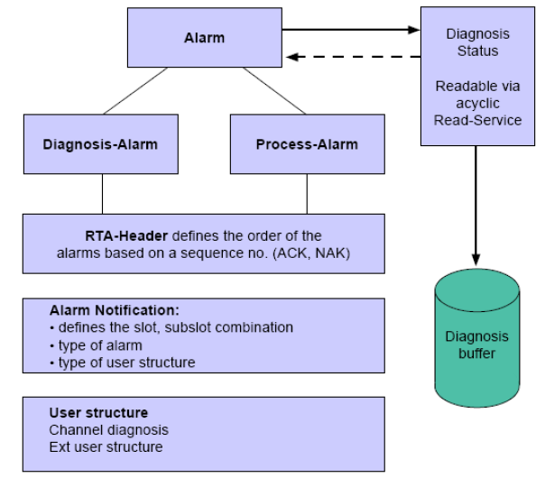
PROFINET I/O Alarms
The overview figure shows the main structure of an alarm message or diagnostic entry used to signal an event. Any fatal error is always signaled as an alarm. Every alarm triggers an entry in the diagnostic buffer.

Slide 45
PROFINET I/O Alarms
It is possible to send alarms as follows:
After an IO device was parameterized with Connect (Recovery)
When an event occurs in the field device
When an event occurs in the connected process

Slide 46
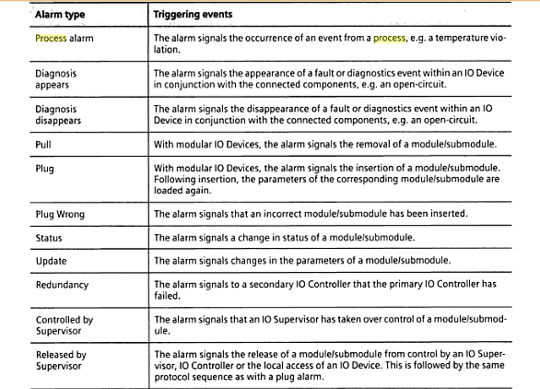
PROFINET I/O Alarm Types

Slide 47
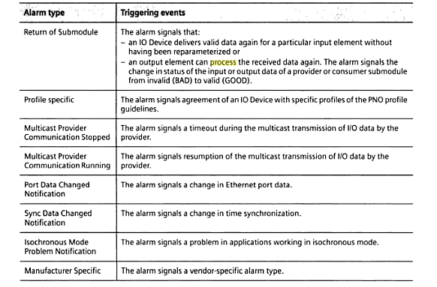
PROFINET I/O Alarm Types contd…

Slide 48
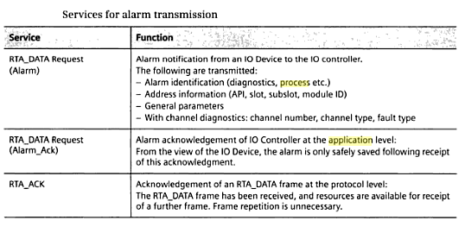
Alarm transmission sequence

Slide 49
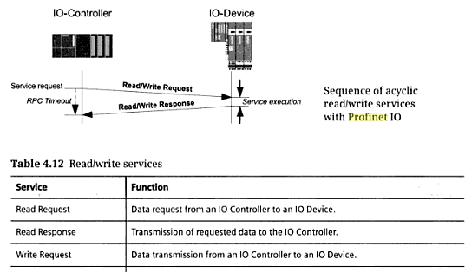
Acyclic data transmission
Non time-critical data are exchanged using acyclic data transmission
Takes place in NRT communication channel using Remote Procedural Calls (RPC) based on UDP/IP
Read/Write services are always consist of request and a subsequent response

Slide 50
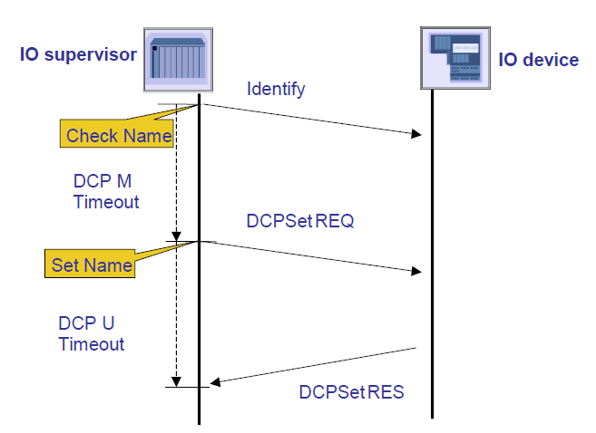
Name assignment with DCP

Slide 51
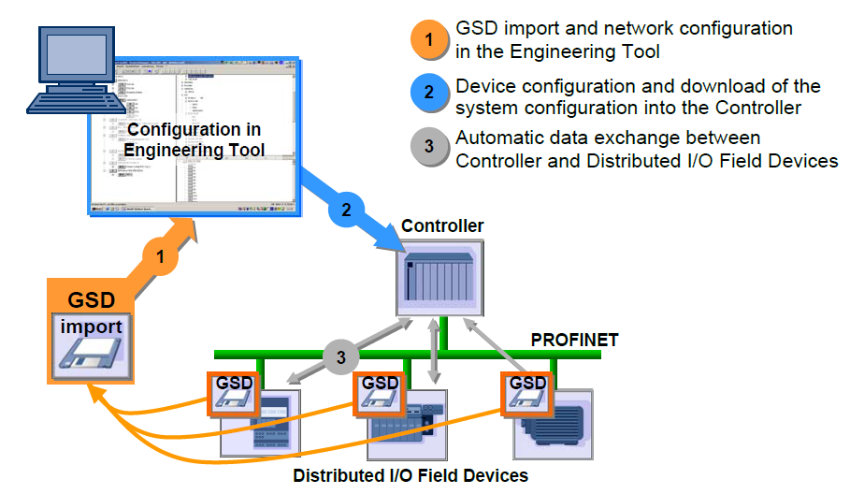
Engineering & Data Exchange

Slide 52
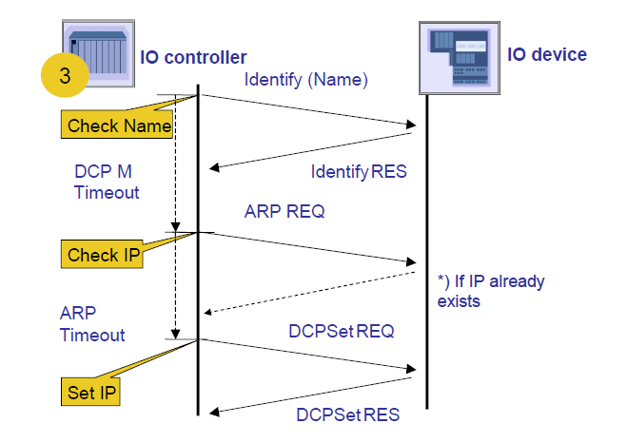
IP address assignment with DCP

Slide 53
PROFINET Context Manager (CM)
Context management (CM):
Context manager manages the Application Relations (ARs) and Communication Relations (CRs) between IO controller and IO device
Initializes ARs and CRs
Setting relevant parameter for CRs Ex: timeouts and operating modes
Parameterization of Ethernet Device Driver (EDD)
Distribution of Parameters described in GSD
Implementation of Un-ambiguous identification of Data Exchange

Slide 54
PROFINET Device Startup
Start MAC interface
Start LLDP (if supported)
Neighborhood information exchange
Start PDev
Station name and IP parameter assignment
Start Context Manager
Management of parameter and configuration data according to GSD file (check during startup, e.g., value range of analog modules) for an API.
Parameter monitoring for an AR
Establishment/clearance of an AR
Management of slots/sub-slots for I/O data

Slide 55
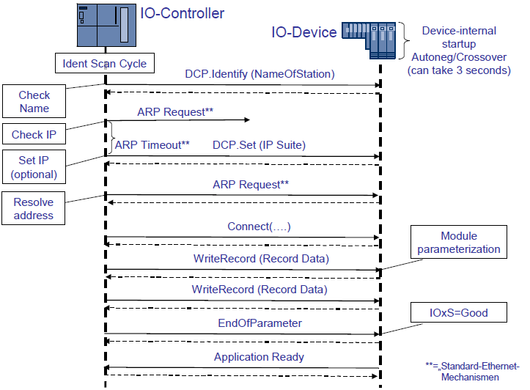
PROFINET Device Startup

Slide 56
Engineering & Data Exchange

Slide 57
PROFINET IO Device Startup Classes
Applications that require short startup times therefore necessitate a transition from PROFINET IO to Interbus or PROFIBUS
As a result of the requirement, the startup is divided into three classes.
Normal StartUp (NSU)
Denotes the normal startup (7 seconds).
Accelerated StartUp (ASU)
Denotes a accelerated startup of the I/O devices within a time of less than 2 seconds (future startup procedure).
Fast StartUp (FSU)
Denotes a prioritized startup of selected I/O devices within a time less than 500 ms.

Slide 58
PROFINET IO Startup Frames
Connect frame: Establishment of an AR and the configured CRs.
Write frame: Parameterizing of all configured submodules.
DControl frame: End detection of parameterization of the IO-Controller (also called ‘EndOfParameterization’).
CControl frame: End detection of parameterization of the IO-Device (also called ‘Application Ready’).

Slide 59

PROFINET IO Frame Structure
Not all layers are needed

Slide 60

PROFINET IO Frame Structure

Slide 61

PROFINET IO Frame Structure
Prioritizing PROFINET RT Frames with VLAN-ID

Slide 62

PROFINET IO Frame Structure
Connection Request Frame:
What is transferred?
RPC: Version(CLRPC), format, Object UUID, Interface UUID,…
NDR (Network Data Representation): length of data, error codes...
AR Block: Version, ARUUID, session key, CMI-Object UUID, CMInactivity-Timeout, length, station name
CR Input: version, IOCR-prop (RT_CLASS_), IOCR data length, send clock, red.ratio, phase, send offset,multicast Addr. (01-0E-CF-00-01-00), API, slot, subslot, offset in frame,....
CR Output: version, IOCR-prop, IOCR data length, send clock,red.ratio, phase, send offset,multicast Addr.(01-0E-CF-00-01-00 f orRT_CLASS_ 2 and 3), API, slot, su-bslot, offset in frame,....
Multicast CR: Provider or Consumer
Alarm: version, 0x8892, time-out, VLAN tag, ...

Slide 63

PROFINET IO Frame Structure
Creating Data structure:

Slide 64

PROFINET IO Frame Structure
Connection Request Frame:

Slide 65

PROFINET IO Frame Structure
Transmitting Cyclical Data (Device -> Controller):

Slide 66

PROFINET IO Frame Structure
Connection Response Frame

Slide 67

PROFINET IO Frame Structure
Read Frame

Slide 68

PROFINET IO Frame Structure
Write Frame

Slide 69

PROFINET IO Frame Structure
End of Parameterization

Slide 70

PROFINET IO Frame Structure
Ready Frame

Slide 71

PROFINET IO Frame Structure
Alarm Frame

Slide 72
PROFINET Features

Slide 73

PROFINET Features
Simple Device Replacement

Slide 74

PROFINET Features
Configuration-in-Run (CiR)
Uninterrupted plant operation including when reconfiguring devices and networks and when inserting, removing, or replacing devices or individual modules plays an important role in process automation .
All of these “Configuration in Run” measures (CiR) are carried out in PROFINET bumpless and without adversely affecting network communication. This ensures that plant repairs, modifications, or expansions can be performed without a plant shutdown in continuous production processes, as well.

Slide 75


PROFINET Features
Device Discovery (Neighborhood Detection) via LLDP
Automation systems can be configured flexibly in a line, star, or tree structure. To compare the specified and actual topologies, i.e., to determine which field devices are connected to which switch port and to identify the respective port neighbor, LLDP according to IEEE 802.1 AB was applied in PROFINET IO.
PROFINET field devices exchange existing addressing information with connected neighbor devices via each switch port. The neighbor devices are thereby unambiguously identified and their physical location is determined (example in Figure 12: The delta device is connected to port 003 of switch 1 via port 001).

Slide 76

PROFINET Features
Device Fast StartUp (FSU)
Fast Start Up (FSU) defines an optimized system power-up in which data exchange begins much faster starting with the second power-up since many parameters are already stored in the field devices. This optional path can be used in parallel to standard power-up (which is still used after a Power On and during the first power-up or reset). It must be possible to store communication parameters retentively for this.

Slide 77

PROFINET Features
Device Fast StartUp (FSU) contd…

Slide 78

PROFINET Features
Web Integration

Slide 79
PROFINET Features
Tool Calling Interface (TCI)
Complex devices, such as drives, laser scanners, etc., often have their own engineering software and tools for making settings for these IODevices.
With the tool calling interface (TCI) these device tools can now be called directly from the plant engineering system for parameter assignment and diagnostics. In this case, the communication of PROFINET is used directly for the settings in the field device.
In addition to the directly integrated device tools, other technologies such as EDDL and FDT can also be used with appropriate adaption software.
TCI consists of the following
Main components:
Call interface: The user can call various field device user interfaces (Device Tools = DT) from the engineering system (ES). Functions are primarily initiated in the device tools through user interaction.
Communication interface: The TCI communication server allows the field device user interface (DT) to communicate with the field device.

Slide 80

PROFINET Features
Tool Calling Interface (TCI) contd…

Slide 81

PROFINET Features
Shared Device
Sharing is at sub-module level

Slide 82

PROFINET Features
i-Device

Slide 83

PROFINET Features
Shared + i-Device

Slide 84

PROFINET Features
Network Management using SNMP

Slide 85

PROFINET Features
Network Management using SNMP

Slide 86

PROFINET Features
SNMP+LLDP – Network Management Software (Siemens SINEMA)

Slide 87

PROFINET Features
SNMP+LLDP – T+H TH-Link and TH-Scope

Slide 88

PROFINET Features
Extended Device Identification (Identification & Maintenance Functions)
Further information for standardized and simplified identification and maintenance is defined in additional I&M data records. I&M1-4 contain plant specific information, such as installation location and date, and are created during configuration and written to the device.

Slide 89

PROFINET Features
Individual Parameter Server
The individual technology related parameters (e.g. the field definitions for a laser scanner) PROFINET IO device or module shall be saved in the PLC and restored at request.
With the function block FB24 "IPARSERV" individual technology related parameters ("iParameter") of any non-safety PROFINET IO device, or module can be saved on the PN IOController.

Slide 90



PROFINET Features
MRP – Media Redundancy Protocol
Based on ring topology.
Max. number (50) of ring nodes of PN IO controller ,PN IO devices and Network infrastructure components (switches)
Configuration and Diagnostic in Engineering
Reconfiguration time 200ms
One MRP Master (Ex PLC) is mandatory in the ring, other devices can be MRP client

Slide 91
PROFINET Features
Clock Synchronization using PTC-P
PTC-P – Precision Transparent Clock Protocol
Must for IRT mode operation
In large plants, the ability to assign alarms and status messages to a sequence of events is often required. For this purpose, an optional time stamping of these messages is possible in PROFINET IO.
In order to time stamp data and alarms, the relevant field devices must have the same time of day. To accomplish this, a master clock and the time synchronization protocol are used to set the clocks to the same time.

Slide 92

PROFINET Features
PTC-P – Functional Principle:

Slide 93

PROFINET Features
IRT Operation & Scheduling

Slide 94
PROFINET Topologies

Slide 95

PROFINET Topologies
Supported Topologies
Linear Bus (Line), Star, Ring, Tree

Slide 96

PROFINET Topologies
Wireless Topology

Slide 97
Fieldbus Integration

Slide 98

PROFINET –Fieldbus Integration
Integrating Profibus DP/Profibus PA

Slide 99

PROFINET –Fieldbus Integration
Integrating Profibus DP/Profibus PA using Hilscher Proxy
Single Profibus DP device using hilscher netLink NL 51N-DPL

Slide 100

PROFINET –Fieldbus Integration
Integrating Profibus DP/Profibus PA using Hilscher Proxy
Multiple Profibus DP device using Hilscher netTap NT 100-RE-DP

Slide 101

PROFINET –Fieldbus Integration
Integrating IO-Link

Slide 102

PROFINET –Fieldbus Integration
Integrating AS-Interface using Proxy (SIEMENS IE/AS-I Link)

Slide 103

PROFINET –Fieldbus Integration
Integrating Interbus using Phoenix contact Proxy FL NP PND- 4TX PB

Slide 104

PROFINET –Fieldbus Integration
HART Over PROFINET:
Used mostly for Device Management
Devices can be wired (ET200M with HART Analog input) or Wireless(WirelessHART)

Slide 105

PROFINET –Device Management
SIMATIC PDM – Devices connected to PROFINET

Slide 106

PROFINET –Device Management
SIMATIC PDM – Devices connected to PROFIBUS DP

Slide 107

PROFINET –Device Management
PROFINET and Device Management (Integrated):

Slide 108
PROFINET –Fieldbus Integration
Other Fieldbus integration:
Integration with following Fieldbus/Protocols are also possible but they are more of gateway integration than integration via Proxy.
Modbus RTU
Modbus TCP
DeviceNet
CANOpen
Foundation Fieldbus
EtherNet/IP

Slide 109
Profiles

Slide 110
Profiles
Available Protocol Independent Application Profiles
PROFIsafe
PROFIdrive
PROFIenergy
Train profile for PROFINET
PA Profile for Process Automation

Slide 111


Profiles
PROFIsafe:
Used for Safety controller-Safety I/O communication
Protocol Independent (Can be used on Profibus or Profinet)
Works based on Black-Channel Principle, Meets SIL3 requirements

Slide 112

Profiles
PROFIsafe:
F-Host

Slide 113

Profiles
PROFIdrive
The PROFIdrive profile describes the drive interface from the point of view of the control application, along with its mapping on the communication system.
It covers scenarios from simple frequency converters to highly dynamic servo drives

Slide 114
Profiles
PROFIdrive application classes:
Category 1 – Standard drives (such as pumps, fans, stirring units, etc.)
Category 2 – Standard drives with technology functions
Category 3 – Positioning drives
Category 4 – Motion control drives with central, higher-level motion control intelligence and the patented "Dynamic Servo Control" position control concept
Category 5 – Motion control drives with central, higher-level motion control intelligence and position set point interface
Category 6 – Motion control drives with distributed motion control intelligence integrated in the drives

Slide 115

Profiles
PROFIenergy:
No additional wiring required
Energy consuming Units (ECUs)(Ex. Motors) are switched off when it is not required and re-started just before when it is needed through coordinated switching

Slide 116
PROFINET Diagnostics

Slide 117
PROFINET Diagnostics
Network diagnostics using SNMP (already discussed)
Frame analysis using Wireshark
Frame analysis using NETLITIES

Slide 118

PROFINET Diagnostics
Frame analysis using Wireshark
No special hardware required, port mirroring is sufficient
PROFINET Specific coloring rules(.ini files) can be imported and applied

Slide 119

PROFINET Diagnostics
Wireshark Supported PROFINET Protocol and coloring rules:

Slide 120

PROFINET Diagnostics
Frame analysis using PROCENTEC NETILITIES
Special hardware (PROFITAP) is required
Live List, SNMP diagnostics, topology detection, Wireshark analysis possible using NETILITIES software
ProfiTap helps capturing logs in wireshark without the need of port mirroring

Slide 121

PROFINET Diagnostics
Live List:

Slide 122

PROFINET Diagnostics
Live List:

Slide 123

PROFINET Diagnostics
SNMP Diagnostics:

Slide 124

PROFINET Diagnostics
Topology Detection:

Slide 125
PROFINET Cabling System

Slide 126
PROFINET Cabling System
Components:
PROFINET Switches
Industrial Ethernet cable
Ethernet connectors
IP connectors for outdoor
Fast Connect connectors
Cable Tester
Wireless System
Fiber optic Converter

Slide 127

PROFINET Cabling System & Interconnection
Wireless System: R-Coax Cable
Useful for rotary equipments
1 section can be 80m long

Slide 128

PROFINET Cabling System & Interconnection
Cable Tester

Slide 129

PROFINET Cabling System & Interconnection
Fast Connect (FC) Technology:

Slide 130


PROFINET Cabling System & Interconnection
Fast Connect (FC) RJ 45 plug:
M12 plug:

Slide 131


PROFINET Cabling System & Interconnection
Industrial Ethernet FastConnect Cable 2 x 2
Industrial Ethernet FastConnect Cable 4 x 2

Slide 132

PROFINET Cabling System & Interconnection
POF and PCF fiber-optic cables:

Slide 133

PROFINET Cabling System & Interconnection
Industrial EtherNet switches and media converters

Slide 134

PROFINET Cabling System & Interconnection
SCALANCE X-000 unmanaged switch:

Slide 135


PROFINET Cabling System & Interconnection
SCALANCE X-100 Media Converters:
Single Mode & Multi mode fiber converters
Both LC and ST Type connectors possible

Slide 136

PROFINET Cabling System & Interconnection
SCALANCE X-200 managed switch:

Slide 137

PROFINET Cabling System & Interconnection
SCALANCE X-400 managed switch-Layer 3:

Slide 138

PROFINET Cabling System & Interconnection
Wireless Communication:

Slide 139
PROFINET Cabling System & Interconnection
Wireless Communication:

Slide 140
PROFINET Device Simulators

Slide 141


PROFINET Device Simulators
SIEMENS SIMBA PNIO
Can be used for virtual commissioning & Factory Acceptance Test (FAT)
Can be used for development and testing
Can be used for Product Demos
Can be used for Operator Training
2 Models available for 128/256 Devices
Both Data and Alarm simulation is possible

Slide 142
Demos

Slide 143
Demos
Sycon.Net for ProfiNet
Importing GSDML files
ProfiNet IO Engineering
Configuring Profibus DP, Interbus, AS-i Devices via Proxy
WireShark Analysis
DTMs for Profibus PA Devices
DTMs for HART Devices
ProfiNet Network Load Calculator Tool

Slide 144
Books
Books:
Automating with PROFINET by Raimond Pigen and Mark Metter
Industrial communication with PROFINET by Manfred Popp

Slide 145
Any Questions?

